Slide 1

Walmart Superstore Sales Analysis
Task
To analyze its sales data to identify its performance and opportunities for growth.
Tools: Microsoft Excel for data cleaning, Power BI for data visualization
Data cleaning and manipulation Using Microsoft excel
Analysing the data
Cleaning the data by removing extra spaces, duplicates
Filling the missing observation or data using Measures of central tendency.
Finally bringing unstructured data into structured data
Power BI for data visualization
Created interactive charts to bring insights of Profits and sales performance of the store

Slide 2
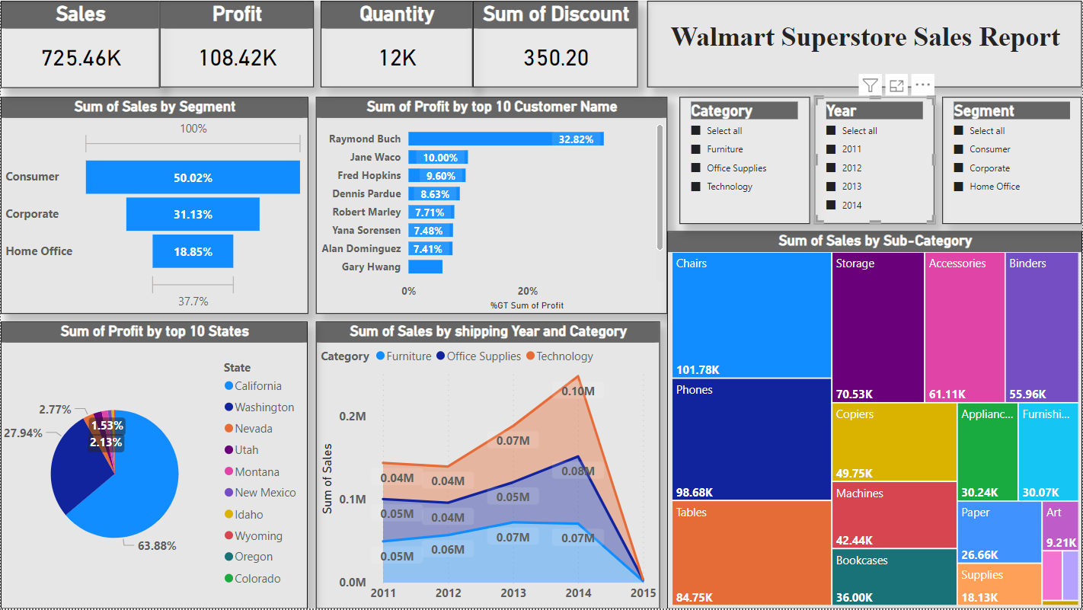
Walmart Superstore Sales Analysis
Summary
Analysed the Walmart super store data and found the maximum profit by the store has been increased gradually and consumer segment has played a topper role for the profit margin followed by corporate and home office segments.

Slide 3
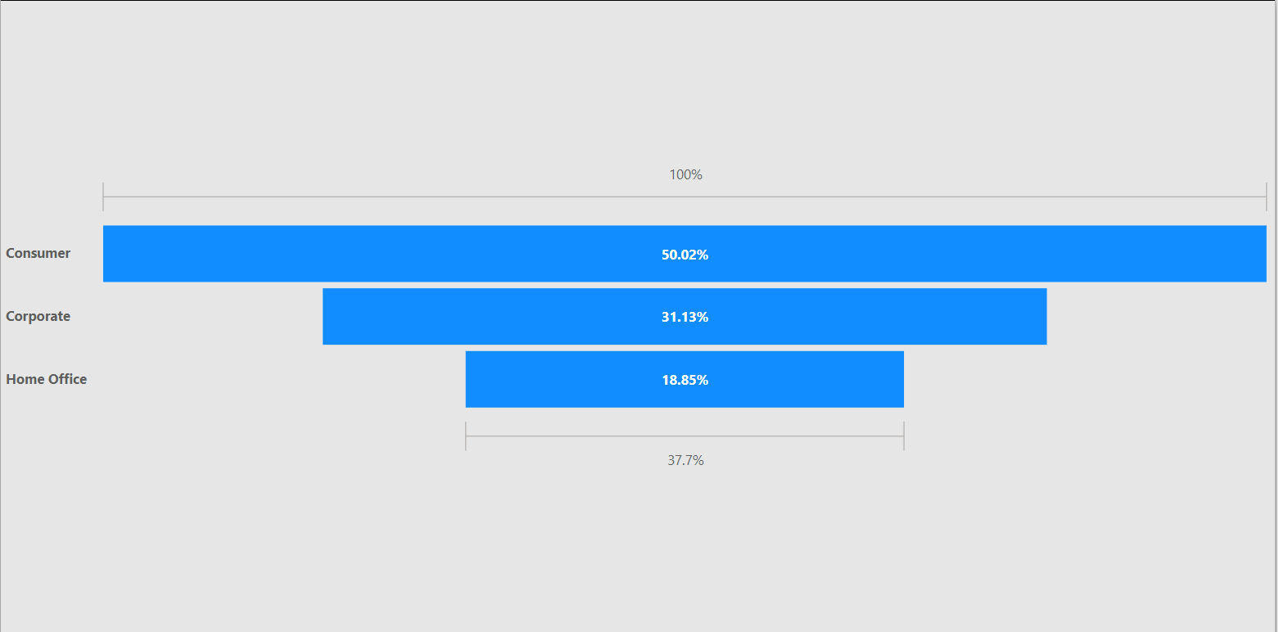
Observation 1
As per the analysis based on Segment, Consumer segment is the most selling components with the percentage of 50.02% in all four years from 2011 to 2014, which reaches half of the sales volume. And followed by corporate with 31.13% and home office category with 18.85%.

Slide 4
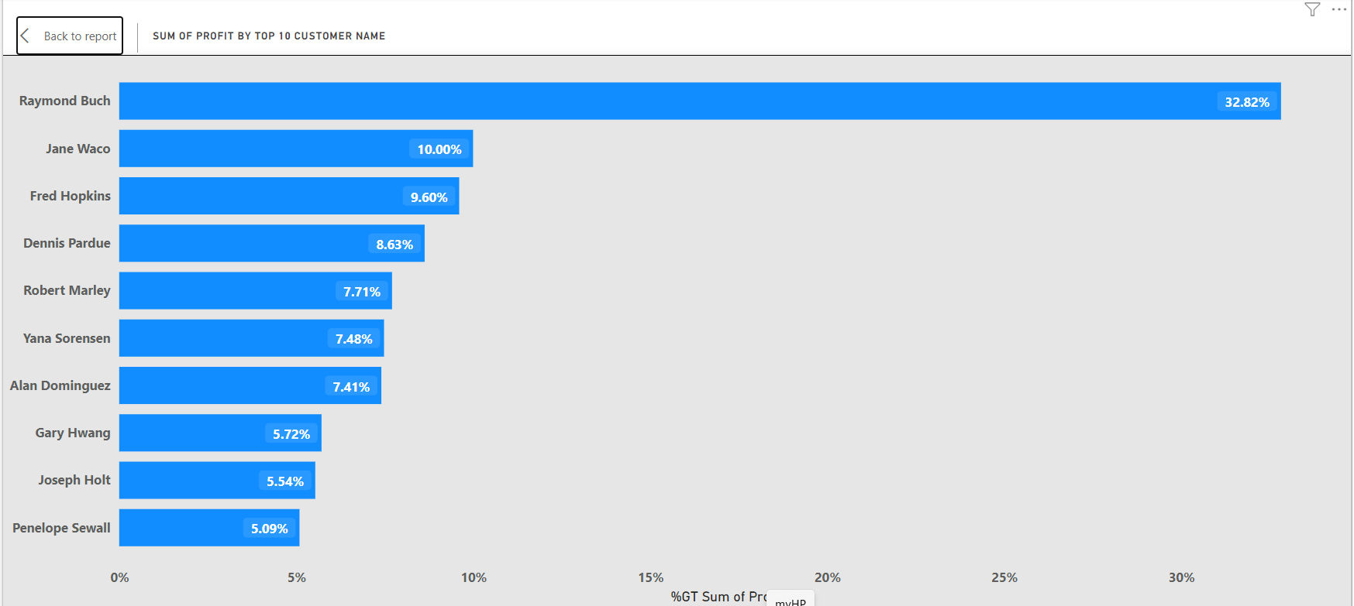
Observation 2
As per the observation below are the top 10 customer which helps the store increasing the profit. As per analysis the profit from the customers are gradually increases in all four years from 2011 to 2014. And at the same consumer products hits the most profitable category.

Slide 5
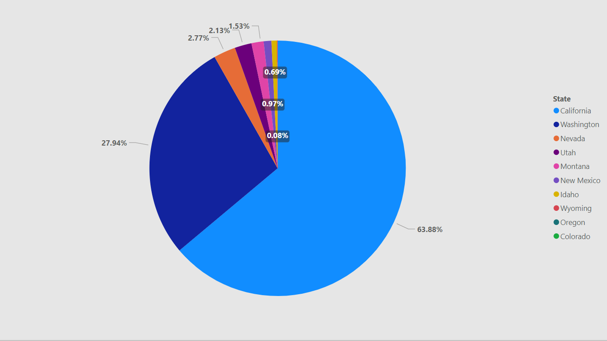
Observation 3
As per the below observation the store gets maximum profit from California state with the percentage of 63.88% and the result is from the consumer segment.

Slide 6
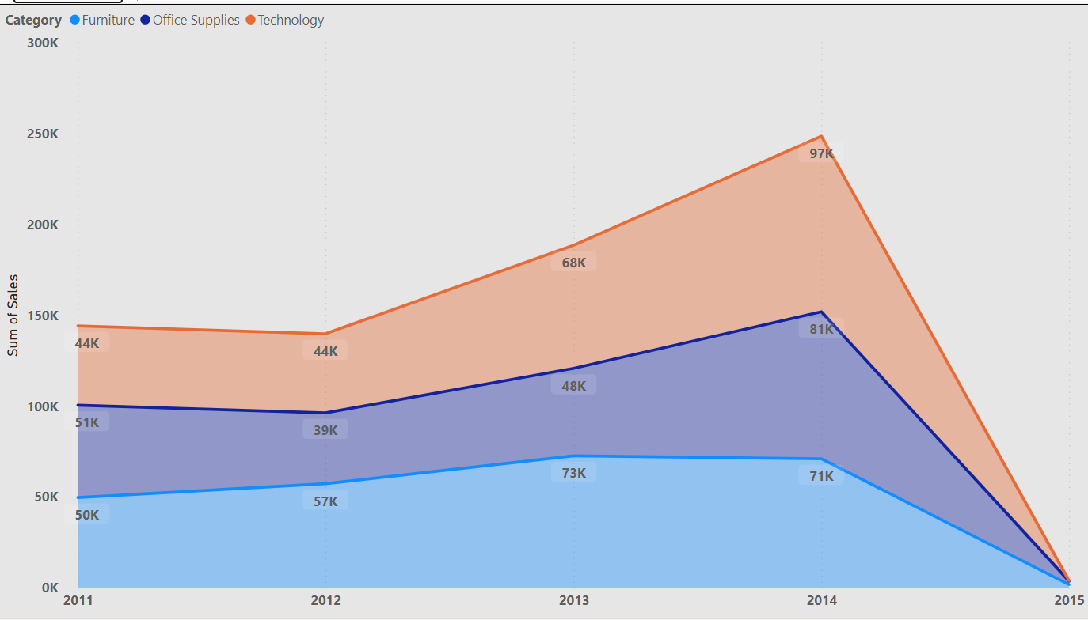
Observation 4
As per the below observation in the maximum sales reaches to $0.10M in the Year 2014 and the maximum sales happened in the technology category for all 5 years from 2011 to 2015.

Slide 7
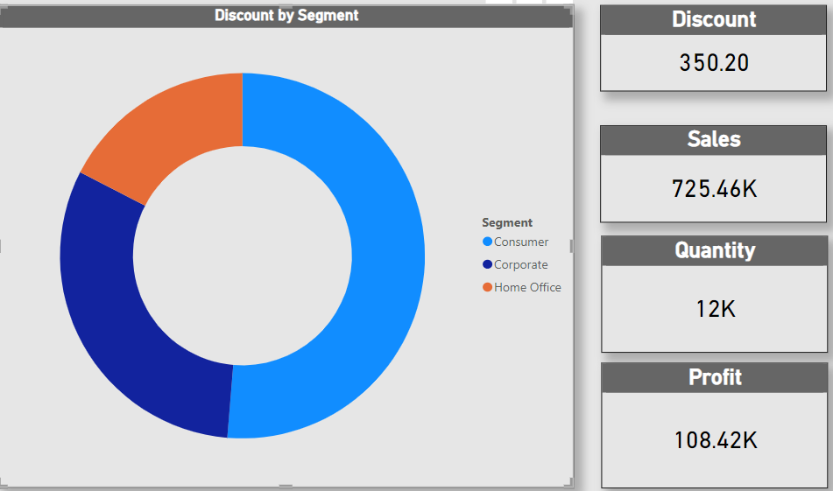
Observation 5
The below observation states the segment vise discounts, Sales, Quantity, Profit

Slide 8
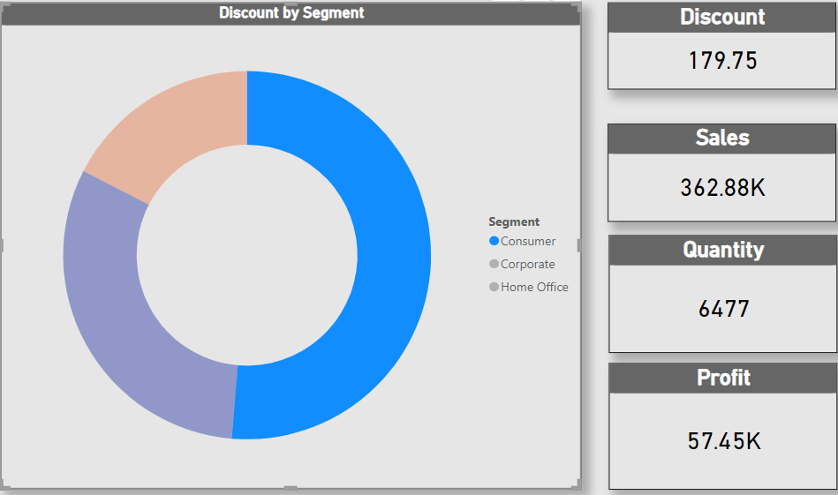
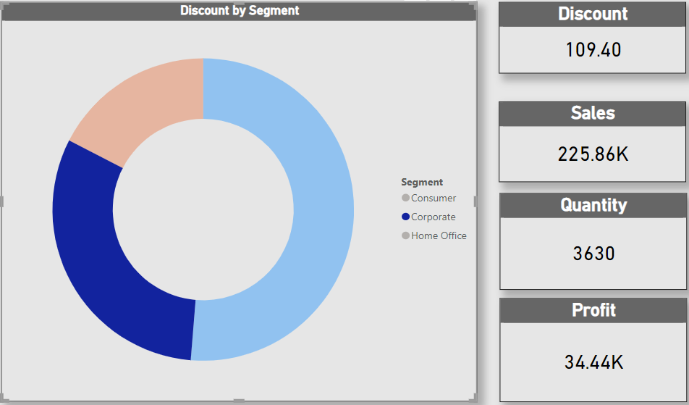
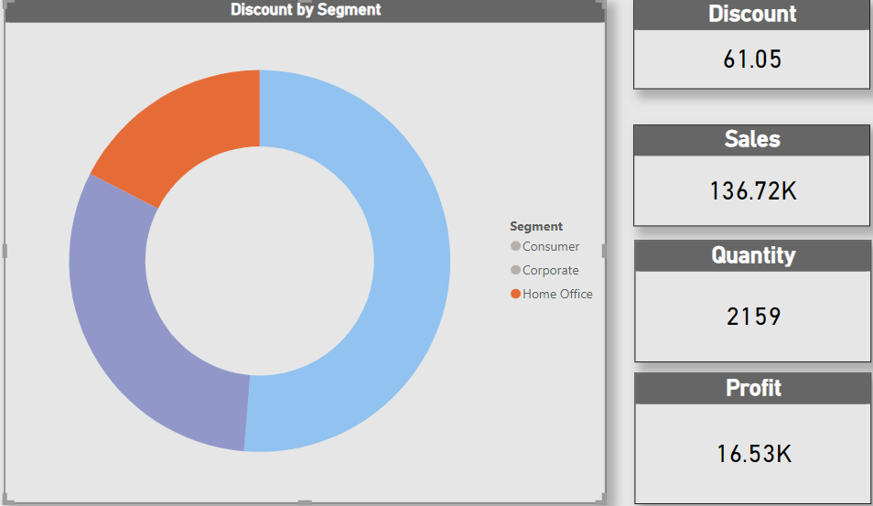
observation says the maximum discount of 179.75% provided for consumer segment and resulted in sales volume of 362.88k with quantity produced of 6477 and the profit margin is 57.45k
observation says the discount of 109.40% provided for corporate segment and resulted in sales volume of 225.86k with quantity produced of 3630 and the profit margin is 34.44k
Below observation says the least discount of 61.05% provided for home Office segment and resulted in sales volume of 136.72k with quantity produced of 2159 and the profit margin is 16.53k

Slide 9
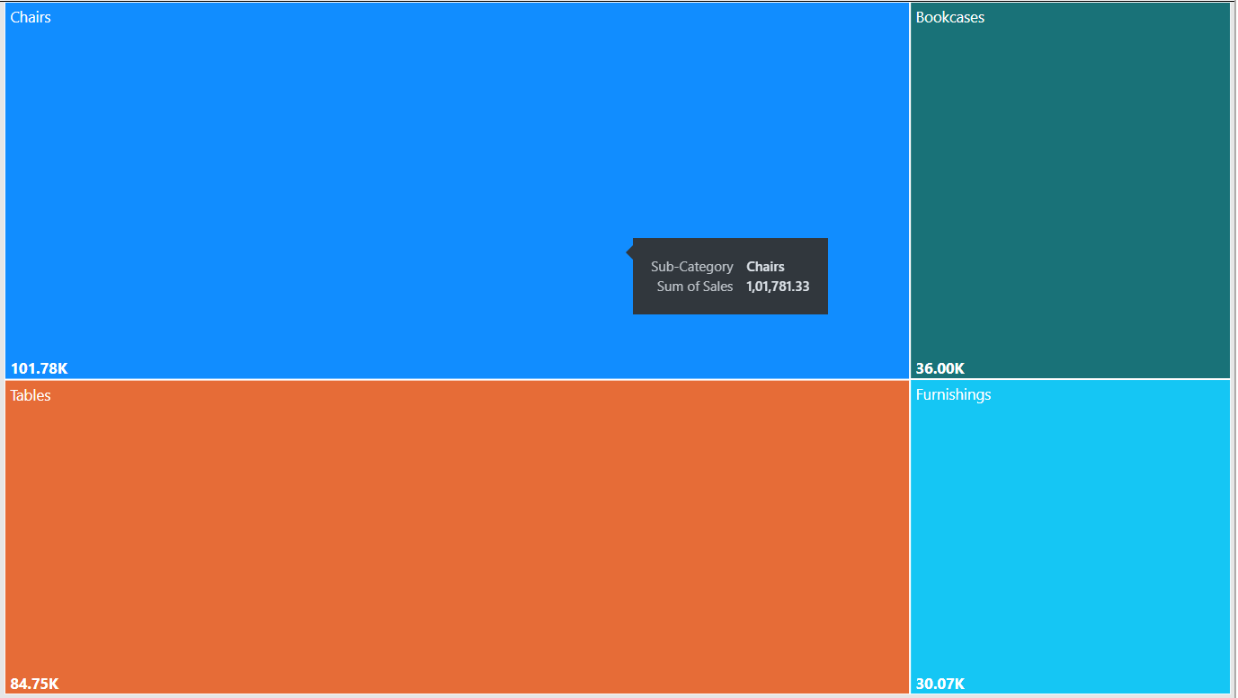
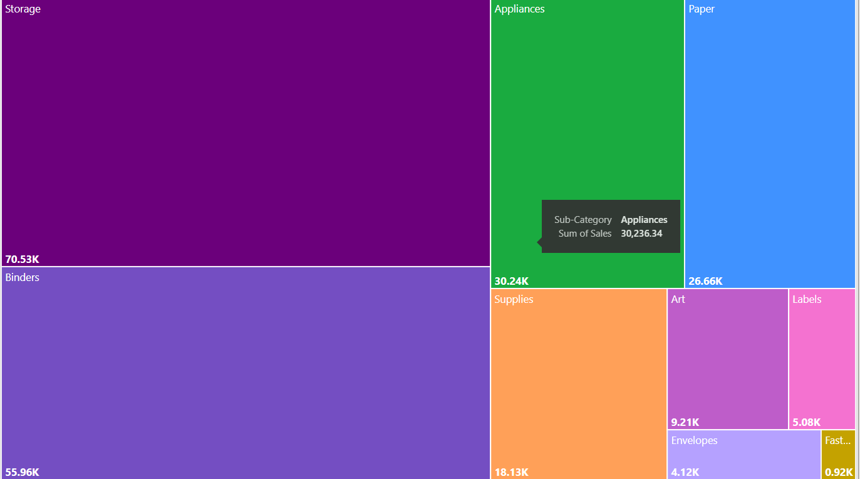
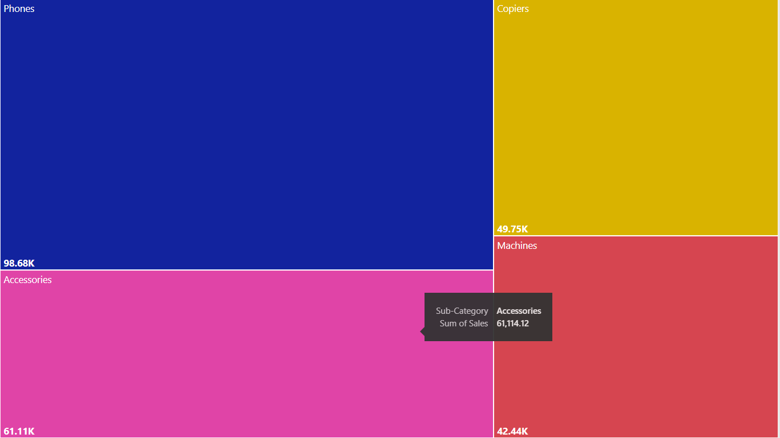
Observation 6
Below observation states about the category vise profit, in Furniture category the profit value is $11.50k, by office supplies category the profit value is $52.61k followed by technology category which profit value is $44.30k
Furniture category
Office supplies
Technology

Slide 10
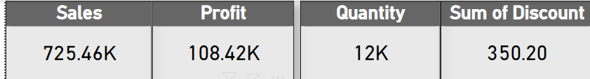
Observation 7
Below results states the overall sales, profit, quantity and discount provided by the store
Conclusion:
Based on the analysis the home office segment has to be concentrated to increase their profit margin
California and Washington states provides maximum profits of the store so concentrating on the development of stores in other states will also help us to increase the profit as well.
- Aswin A

